Slide 1

NOISE AND AIR POLLUTION MONITORING SYSTEM
Under the guidance of Dr.Joice T
MCA main project:
Angel A B
MCA-A Roll No 24

Slide 2
01
Relevance of the project
02
A Description of the Project
03
Existing System and Proposed System
Contents
CONTENTS
04
System Design
05
About User interface design and Back-end design
06
Input and Output modules
07
Dataset

Slide 3
01
Relevance of topic
Contents

Slide 4
Relevance of the project
The increasing air and sound pollution is one of the significant issue now days. As the pollution increasing it is giving rise number of diseases so, it has become essential to control the pollution for better future and healthy life .here we propose an air quality as well as sound pollution monitoring system that allows us to monitor and check live air quality as well as sound pollution monitoring in particular areas through IOT.
System uses air sensor to detect or sense presence of harmful gases, compounds in the air and constantly transmit data to microcontroller. Also system keeps measure sound level and report it to the online server over IOT.
The user friendly and easy handling of the system technology is such that it can be installed in houses, schools and in small places.

Slide 5
02
A Description of the Project
Contents

Slide 6
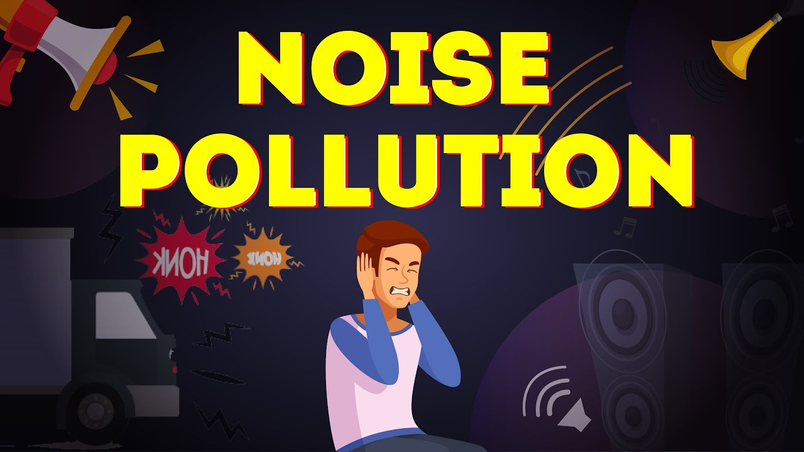
Description
Air and sound pollution is a growing issue these days. It is necessary to monitor air quality and keep it under control for a better future and healthy living for all. Here we propose an air quality as well as sound pollution monitoring system that allows us to monitor and check live air quality as well as sound pollution in a particular areas through IOT. System uses air sensors to sense presence of harmful gases/compounds in the air and constantly transmit this data to microcontroller. Also system keeps measuring sound level and reports it to the online server over IOT. The sensors interact with microcontroller which processes this data and transmits it over internet. This allows authorities to monitor air pollution in different areas and take action against it. Also authorities can keep a watch on the noise pollution near schools, hospitals and no honking areas, and if system detects air quality and noise issues it alerts authorities so they can take measures to control the issue.

Slide 7
03
Existing System and Proposed System
Contents

Slide 8
Existing System
In previous existing system used zigbee, microcontroller, and raspberry pi. But our system advanced technology is used. We design a tool which will sense quality of air and sound and temperature display it is the form of percentage. Sense how much carbon dioxide, Carbon-Mono oxide and sulphur dioxde is present in air as well as sound display in the form of decible. Sense the temperature and display it in degree celcius.
Disadvantages
• Wastage of time
• Wastage of effort
• Can’t reach every customers simultaneously .

Slide 9
Proposed System
In future we modify the system to notify a user about
the air quality and noise level it reaches beyond
permissible level through sms or app.
We can monitor air and sound pollution level at any
place of the world.
Advantages
• Save time
• Same effort
• Easy to work
• Can manage every customers simultaneously

Slide 10
05
System Design
Contents

Slide 11
SYSTEM DESIGN
METHDOLOGY
OLED display
Air quality sensor MQ135
Power supply
NodeMCU
Data to server
Sound sensor LM393
Block Diagram of proposed system

Slide 12
05
About User interface design and Back-end design
Contents

Slide 13
User interface design and Back-end design
USER INTERFACE
ANDROID
All user interface elements in an Android app are built using View and View Group objects. A View is an object that draws something on the screen that the user can interact with.
A View Group is an object that holds other View (and View Group) objects in order to define the layout of the interface. Android provides a collection of both View and View Group subclasses that offer you common input controls (such as buttons and text fields) and various layout models (such as a linear or relative layout)

Slide 14
User interface design and Back-end design
BACK END
ARDINO SOFTWARE AND XAMP SERVER
The open-source Arduino Software (IDE) makes it easy to write code and upload it to the board. This software can be used with any Arduino board.
Arduino IDE is a hassle-free, simple, and straightforward programming environment. With a community-driven system and simple interface, the program makes it easier to code websites and applications. You don't need to have any technical skills or knowledge to use beginner-friendly software.

Slide 15
SOFTWARE AND HARDWARE SPECIFICATIONS
SOFTWARE AND HARDWARE SPECIFICATIONS
HARDWARE SPECIFICATIONS
SOFTWARE SPECIFICATIONS
OS->Windows XP
Arduino software
Php,xampserver
MQ135 Air quality sensor
Sound sensorLM393
NodeMCU-ESP8266
OLED Display
cables

Slide 16
06
Input and output modules identified
Contents

Slide 17
Modules
Application Module
Noise controlling module
Air quality module

Slide 18
05
DataSet
Contents

Slide 19
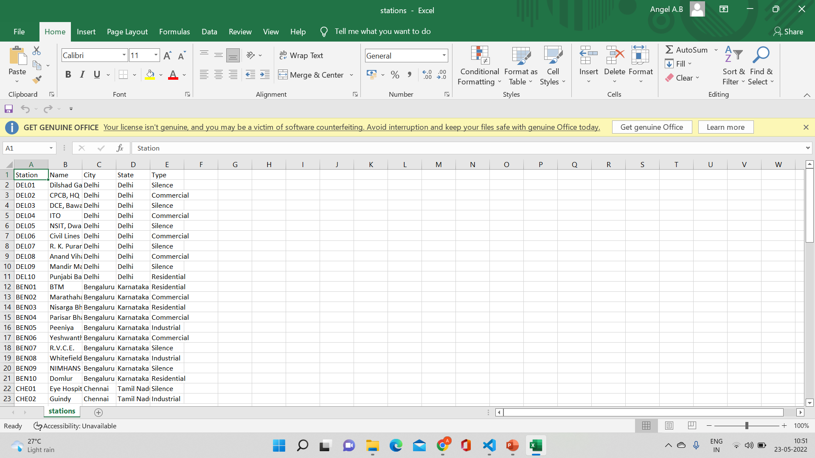
Dataset

Slide 20
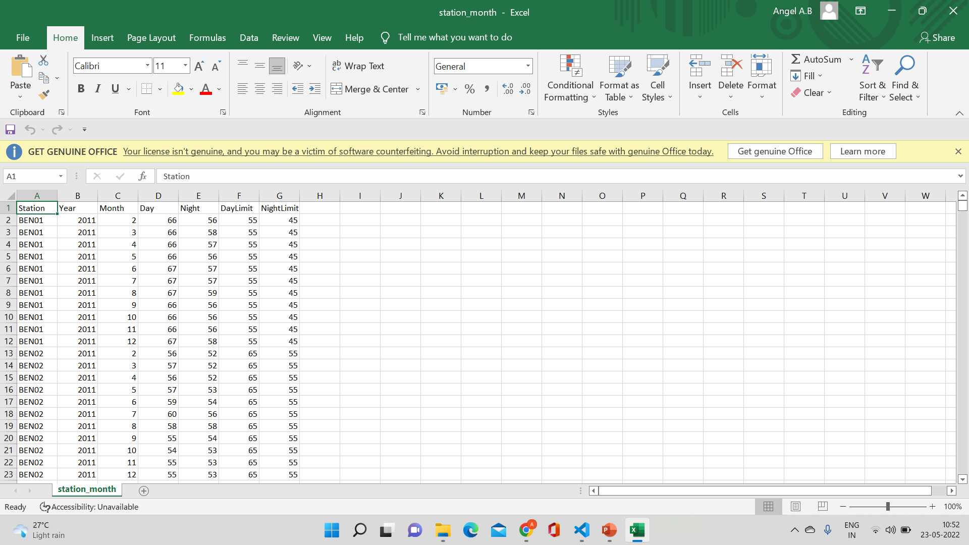
Dataset

Slide 21
NOISE AND AIR POLLUTION MONITORING SYSTEM
THANK YOU

